Slide 1

Cloud Computing – To be or not to be(e)
@SachaLabourey
CEO, CloudBees, Inc.
October 12, 2012 – Paris
©2012 CloudBees, Inc. All Rights Reserved

Slide 2


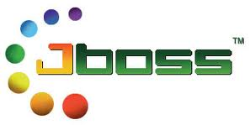
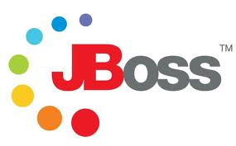


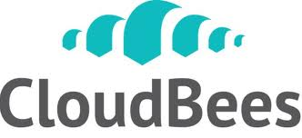
Introduction – Sacha Labourey
Born in 1975 in Switzerland
JBoss
Clustering lead – 2001
GM Europe - 2003
CTO - 2005
Red Hat
JBoss acquisition in June 2006
co-GM of Red Hat’s middleware division
Left Red Hat in April 2009
CloudBees
Started in April 2010
About 30 bees in 6 countries
X

Slide 3
Agenda
Who wants to use the cloud anyway?
Software vs. Services
What does “Cloud” mean to developers?
IaaS vs. PaaS vs. SaaS
A few words on CloudBees
Demo
Q&A

Slide 4
Why do we like the “Cloud”?
Simplify, simplify, simplify

Slide 5
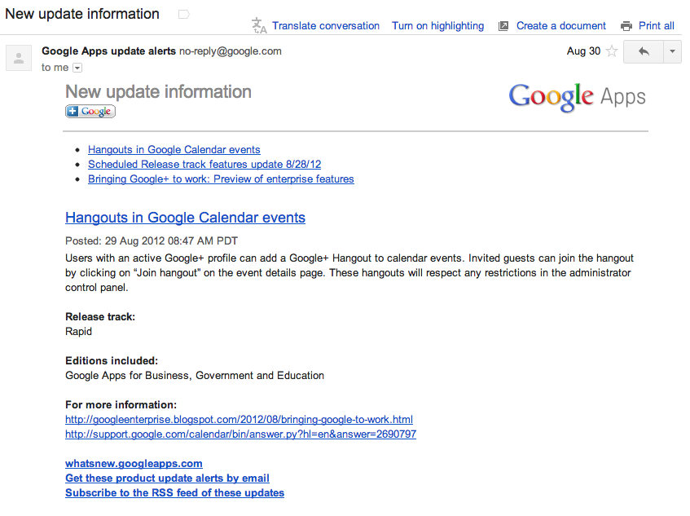
The SaaS “Good Morning” e-mail

Slide 6
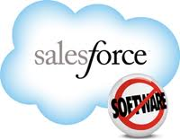


Why do we love the cloud?
vs.
README.txt
« Apply v2_1_4.ddl
before installing v2.1.4 »
update.exe

Slide 7
Why do WE love it?
No long setup process
No hardware nor software acquisition, setup, configuration
“Sign up to get started now!”
Much lower risk
You get to try it first in a “real-life” environment, then scale as you see fit
Scale your spend, as you scale your usage
Available “everywhere”
No upgrade process, no v2.0 nightmare!

Slide 8
Who wants to use the “Cloud”?
The “consumerization of IT”

Slide 9
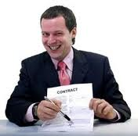
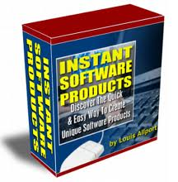
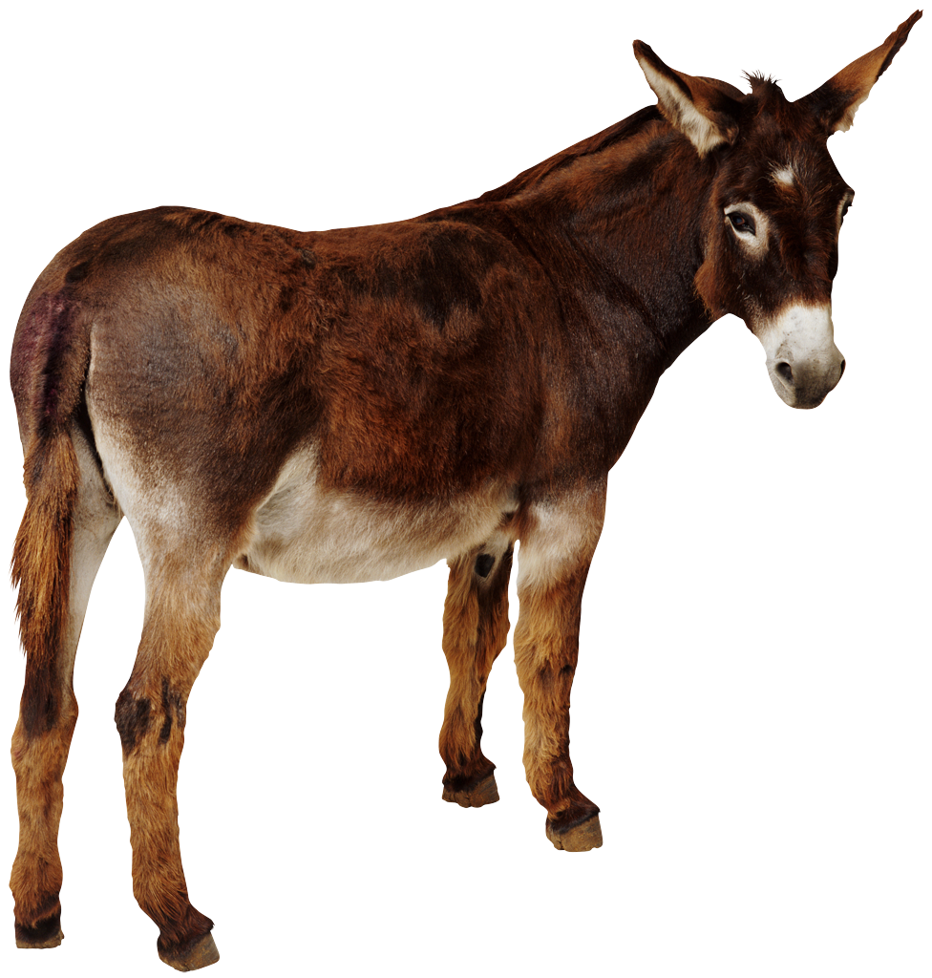
“Mental picture” of most of today’s software vendors
We extensively use SaaS software, it makes us sooooo productive…
… at delivering packaged software to our customers!
#FAIL

Slide 10
TIME TO WAKE-UP!!!
Your customers are no different from you
They don’t like
Shelf-ware, setup, patches, upgrading releases, etc.
They do like
Fast time-to-market, pay-as-you-go, elasticity, mobility, etc.

Slide 11
Drivers & Acceleration
And many drivers are accelerating this transition to Cloud-based services:
Mobile, Social, Big Data, Etc.
Time-to-market is more important than ever!
I need it yesterday!
Can’t afford 18m cycles
Discovery-mode!
And SaaS is already pulling more data in the cloud
Slowly redefines what data is “remote”
On-premises is the new legacy

Slide 12
So, fine, cloud it is – but what’s the big deal?
Software vs. Services

Slide 13
Software vs. Cloud Service
What’s the big difference?
They’re just a long series of 1 and 0 at the end of the day, right?
A cloud Services is not just “hosted software”
i.e. take your current software, host it, and keep doing what you’ve been doing to date

Slide 14
To be or not to be
Software
Service
Release v1.0
Gather requirements for v2.0 
Work on v2.0 for 18 months 
Release v2.0
don’t screw it up: once it is out, it is out.
Have your customer upgrade
Support v1.0 for 3 to 8 years
Support and patch dozen of “branches” in parallel
Gather requirements for v3.0 
Work on v3.0 for 18 months 
…
Release v0.1
Implement micro-feature, deploy, measure success, keep or kill 
Implement micro-feature, deploy, measure success, keep or kill 
Patch a bug
Implement micro-feature, deploy, measure success, keep or kill 
Implement micro-feature, deploy, measure success, keep or kill 
Implement micro-feature, deploy, measure success, keep or kill 
Implement micro-feature, deploy, measure success, keep or kill 
years
weeks

Slide 15
Software != Service
Not the same …
[ requirement gathering | development | QA | success measurement | release | support ]
… processes

Slide 16
Example: Lose it!
Lose it!
Mobile application
> 12 millions users
> 25,000 transactions per minute, at peak time
And… only 4 employees and …2 developers!
No IT, no servers, no DevOps
Complete focus on SOFTWARE DEVELOPMENT
Anything else is handled by CloudBees
Unmatched productivity level!
This is possible TODAY
Will you wait for your competitors to shoot first?

Slide 17
How to get there? What tools?
Iaas vs. PaaS vs. SaaS

Slide 18
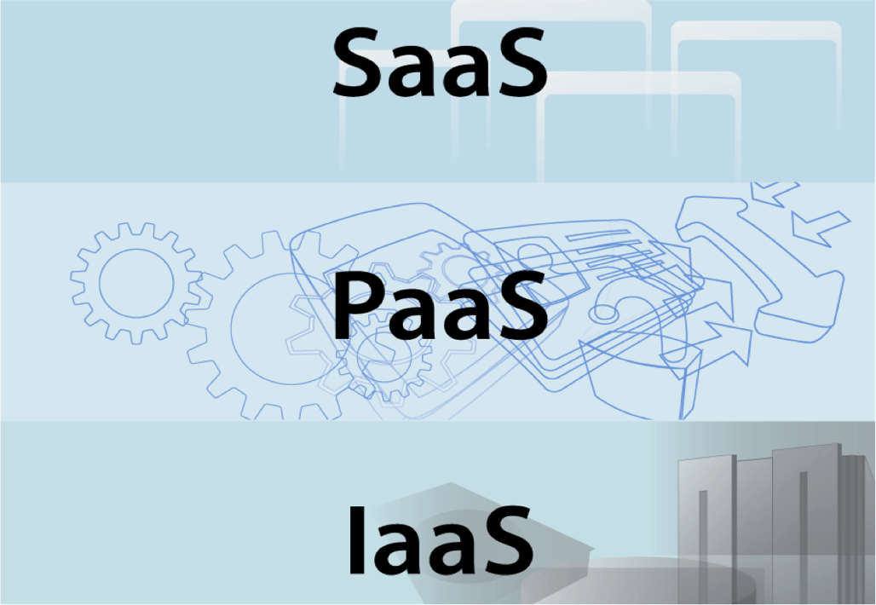
Easy: « Just use a XaaS! »

Slide 19

Traditional software stack We have done this for 20 years!
Application
LB
setup
monitor
Patch
update
validate
AS
JVM
You
VM
Hypervisor
Server

Slide 20
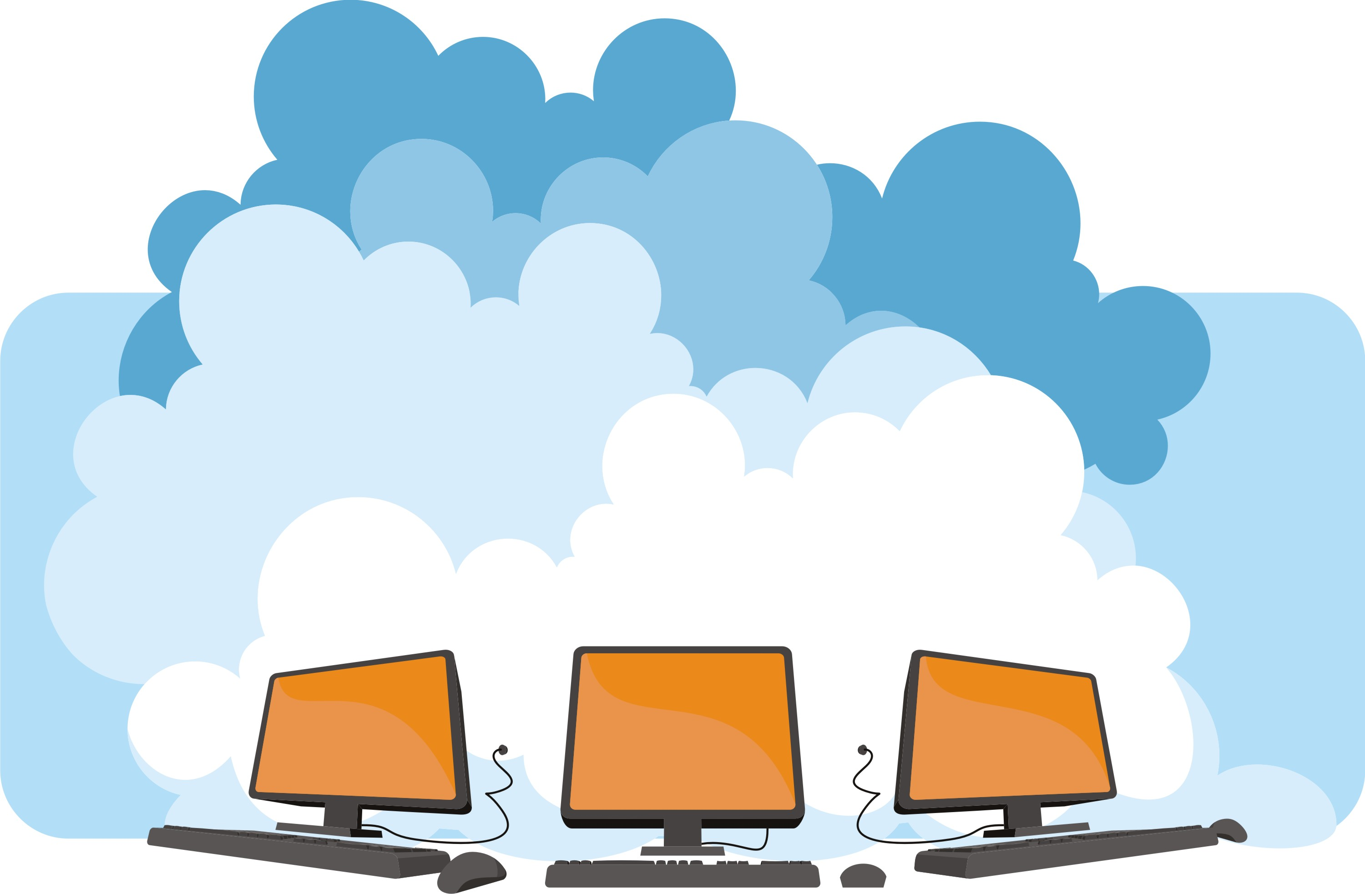
Cloud Computing: How to do it? Who does what?
Applications
LB
AS
setup
Monitor
Patch
Update
Validate
JVM
Cloud Provider?
VM
OS
Servers

Slide 21

SaaS
SalesForce.com, Zendesk, NetSuite, etc.
Development environment
Rigid – mostly through CONFIGURATION
When available “development” takes place within the SaaS itself
User point of view
Standard applications
Very fast bootstrap
Most of the time, lock-in is very high

Slide 22
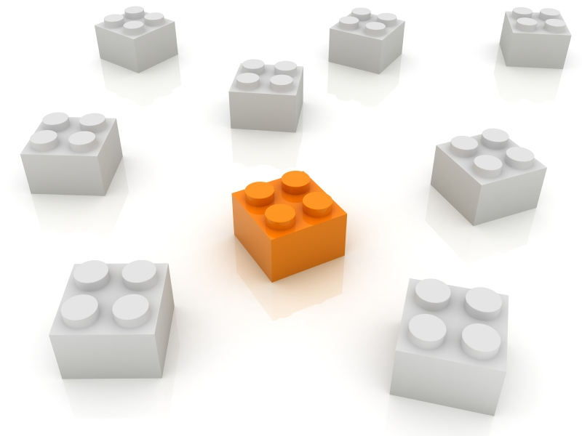
IaaS
AWS – the most popular example
Server Lego blocks – VM, storage, IP, etc.
Development environment:
“Give me a server, an OS, a virtualization layer, an application server, a firewall, a database, I’ll deal with it! And patch it. And monitor it. And…”
Flexible but cOmpLiCaTed
User point of view
Custom systems and environments

Slide 23
IaaS – Let’s try not to change too much…
SUN/HP/IBM/XYZ
?
AWS/Rackspace/etc.
Must probably be the same…

Slide 24
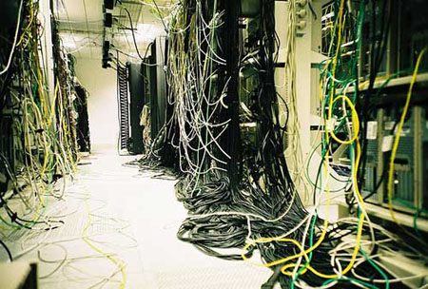
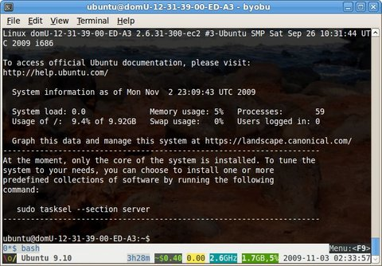
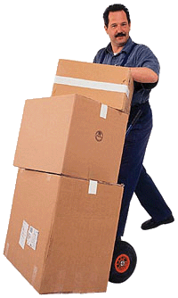
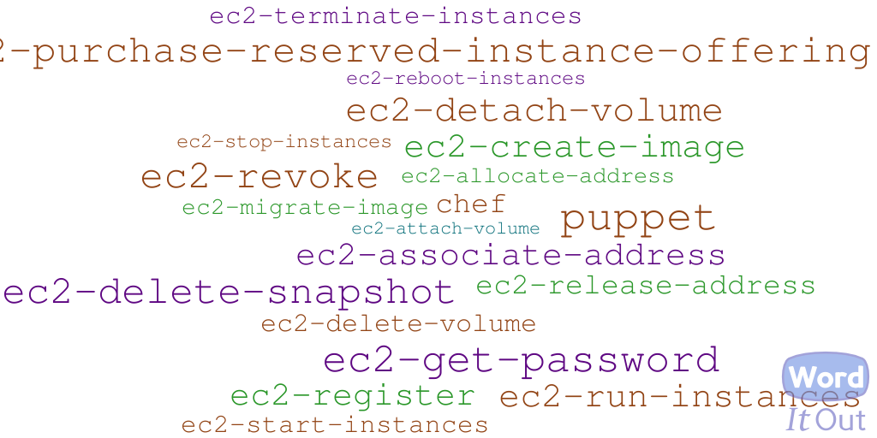
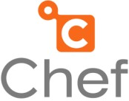
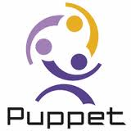
IaaS – Congratulations!
“Great” news: you have now become responsible for the data-center!

Slide 25
IaaS – Consequences
Directly managing your IaaS resources provides you with resource elasticity (CAPEX-free), but…
The amount of soft-IT typically required to do so is … higher!
All of the traditional IT activities remain (maintain/patch/monitor OS+JVM+AS+DB++, etc.)
+ cloud-specific items: elasticity/security/automation
I can read your mind: this is where you will start
My advice? Move on…

Slide 26

PaaS
Cloud concepts are applied to Applications and Data
On-demand, pay-as-you-go, elasticity, etc.
No need to handle updates, patches, scalability, failover, etc.
Development environment
“Give me my typical development environment and manage everything else for me – servers, scalability, etc.”
User point of view
Custom applications
Harder to “grasp” initially
This is a Service, not just some Software!

Slide 27
One last warning…
Could I please get a « Private PaaS »?
Sure! We can also sell you a private jet!
Very tempting! All of the advantages but no “hard decision” about the cloud is needed! And I’ll be able to customize it!
Yes, but…
A great part of the value from a PaaS comes from the « S »: SERVICE
With a public PaaS, you are outsourcing your Operations & DevOps
With a Private PaaS you’ll get a better « interface » between DEV and IT compared to traditional middleware, but, overall, you remain in charge of all operations!
And remember: Customization is the root of all evil!
« Can I get a 160V plug just for this toaster? »
Notes:
STANDARDIZED OFFERING
CRITICAL MASS
SERVICE

Slide 28
Why am I telling you all of this?
Enter into the world of CloudBees!

Slide 29
Why does CloudBees rock?
Deploy app to traditional Java platform
Deploy app to CloudBees
Deploy App:
➔ Provision cluster
Provision DB
Deploy schema
Deploy App to each node
(not a transparent update process)
(transparent,
multi-version,
HA, scalable)
Provision cluster:
DEPLOY
➔provision nodes
Install load-balancer (LB)
Configure LB
Secure LB
Setup BC for cluster
QA cluster
Configure DNS
No need to care about servers, load-balancers, firewalls, backups, etc.
The environment is constantly managed and monitored
Scalability happens in realtime
Integrated failover/HA
We do « Ops », you do « Dev »
Provision DB:
➔ Provision node
Install DB
Configure DB
Secure DB
Setup BC for DB
Provision node:
Configure OS
Secure OS
Setup JVM
Install AS on OS
Configure AS
Secure AS
Manage environment (recurring)
Analyse sec. bulletins
Analyse QA bulletins
Analyse AS/OS logs
maintain OS
maintain JVM
maintain AS
maintain DB
maintain FW
Validate/QA stack
Metering/Scaling (recurring)
Measure App performance
Acquire Hardware
Provision node
Update Cluster
Update LB
Update Security

Slide 30


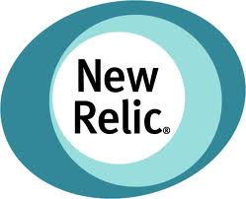

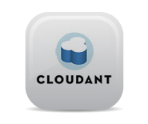
CloudBees Platform as a Service
Development Projects
SaaS Vendor Applications
Enterprise User
Applications
Test
DEV@
RUN@
Code
Deploy
Test
Build
CloudBees Ecosystem
Deploy
Scale
Stage
Build
Jenkins
Continuous Deployment
Production
JVM – Java EE
Java, Python, Scala, …
Iterate
Repositories
Maintenance
GIT
SVN
Maven
…
APIs
CloudBees Core Platform Services
CloudBees Smart Plugins
Databases
Data Services
Messaging
Identity
Logging/ Auditing
Runtime services
Other SaaS
Provisioning
Management
Monitoring
Metering
Billing
Back-end services
On Premise
Public Edition - IaaS Providers
Private Edition - On-Premise

Slide 31
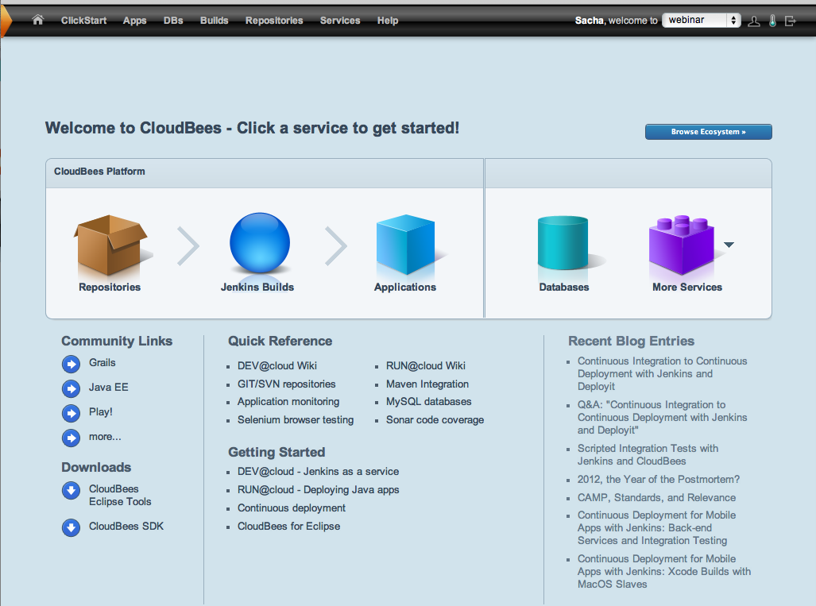

Slide 32
Getting started
Lots of new things to learn!
(delegation of trust, access to legacy data, latency, elasticity, iterativity, etc.)
The cloud is not perfect (yet)
Might not solve all of your current problems
Identify an application
Start small
Non-critical
Learn and Extend
(and enjoy!)

Slide 33

Today’s demo
CloudBees
ClickStart
Git
Jenkins
job
PaaS
runtime
DB
Push notifications
Deploy on success

Slide 34
Today’s demo
5. Full
iteration
Performed!
3. Initiate build&tests
4. Deploy modified app
Git
Jenkins
job
PaaS
runtime
DB
1. Setup IDE
2. Modify code & PUSH
eXo Cloud IDE

Slide 35
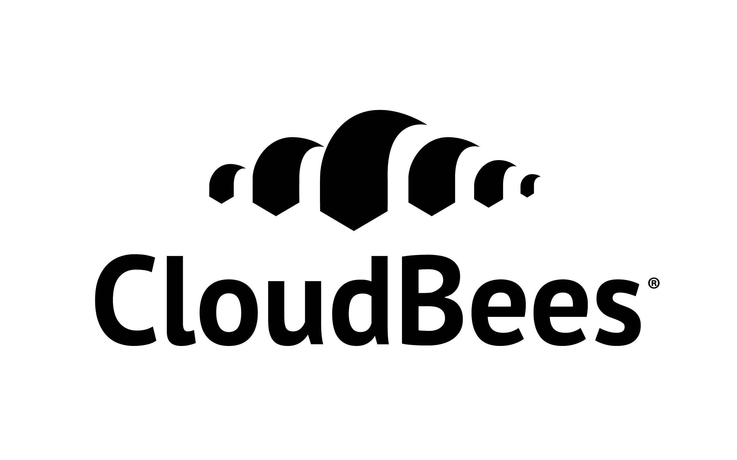
Thank you
“It is easier to ask forgiveness than it is to ask permission”
-- Grace Hopper
@SachaLabourey

